Slide 1






USGS/NIWR FY2025
Nationally Competitive Grants
Proposal Preparation Guidance
August 21, 2025

Slide 2
Today’s webinar:
Introduction to NIWR and state water centers/institutes
Eligibility and how to apply
FY2025 104(g) grants: General, AIS and PFAS – including research priorities
Overview of RFPs with emphasis on budget criteria
USGS collaboration
Self selecting breakout rooms for each program (General, PFAS, AIS)

Slide 3
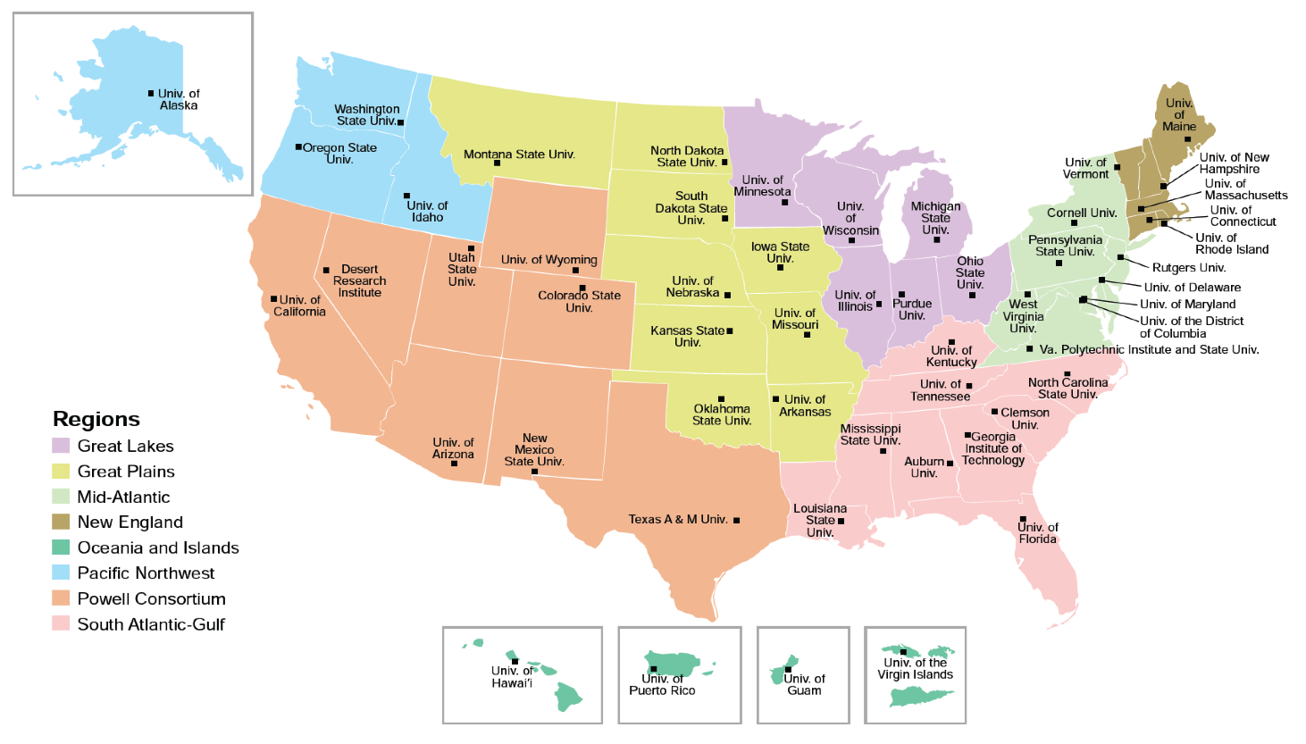


NIWR/USGS overview
Notes:
The National Institutes for Water Resources is made up of 54 Water Resources Research Institutes established under the authority of the Water Resources Research Act. Each of the 50 states, plus the District of Columbia, the Virgin Islands, Puerto Rico and Guam have institutes housed at their land grant university that receive annual base funding through the U.S. Geological Survey to support competent research, train future water scientists, and disseminate research results to water managers and the public.
We are separated into regions and today the Great Lakes region (in purple) representatives have come together to bring you this webinar. We felt there was a need of more awareness for this grant program especially since the geographic limitation for one program is sitting in our backyard.

Slide 4

Eligibility
Any investigator at an accredited institution of higher learning
Investigators in each state must submit through the designated Water Resources Research Institute in that state

Slide 5
How to apply:
Work with your state WRRI contact
Great Lakes:
  IL - Amy Weckle
  IN - Laura Esman
  MI - Jeremiah Asher
  MN - Sarah Roth
  OH - Linda Weavers and John Lenhart
  WI - Jennifer Hauxwell
Application requirements may differ in each state

Slide 6
Timeline
August 15 | USGS released RFP
~ Mid September | Proposal submission deadline to WRRI
September 30 | WRRI proposal submission deadline to grants.gov by your state institute
~ Thanksgiving | USGS announces funding decisions
February 1 | Money disbursed to WRRI awardees (delays always possible)
Other deadlines may include (state dependent):
 | Notice of Intent (NOI) submitted to WRRI
 | Submission of budgets and budget justifications

Slide 7
FY2025 104(g) Nationally Competitive Grants
General
Aquatic Invasive Species (limited to Upper Mississippi River Basin)
Per- and polyfluoroalkyl substances (PFAS)
All three programs focus on:
water problems and issues of a regional or interstate nature beyond those of concern only to a single state, and
concerns related to specific program priorities identified in each RFP

Slide 8
104(g)-General, AIS, PFAS common objectives
Promote the dissemination and application of the results to the scientific community and to the general public.
Assist in the training of scientists in relevant water-related fields. Proposals that include a strong educational component (student support) are encouraged, as are those from early-career faculty.
Note: None of the federally appropriated WRRA monies can be used for federal salary, travel, or any other expenses.

Slide 9
104(g)-General additional objective
104(g)-General additional monies
Promote collaboration between the USGS and university scientists on significant national and regional water-resource issues
Up to $40,000/project of internal USGS funds (non-WRRA appropriated) are available to fund salary and other expenses for a USGS co-PI.
Requires submission of a Statement of Government Involvement including a workplan, budget, and explanation of personnel as well as the SF-424 Budget Information form and Budget Narrative.

Slide 10
104(g)-General priority #1
Economic value of Information of the USGS streamgage network and associated National Water Information System (NWIS).
National Hydrologic Warning Council 2006 report categories (1) through (3)
Hydrologic Unit Maps | U.S. Geological Survey
Congressional Research Service Report – USGS Streamgaging Network: Overview and Issues for Congress
National Water Monitoring Network | U.S. Geological Survey
Federal Priority Streamgages (FPS) and Re-Prioritization of the U.S. Geological Survey
Federal Priority Streamgage Network
Flood_Management_benefits_FinalDraft.indd
nhwc report final 030806.pub
Water Data for the Nation
National Water Dashboard
Explore USGS Water Data

Slide 11
104(g)-General priority #1
Proposals may seek a tradeoff between examining multiple benefit categories at a reduced geographic scale versus a limited number of benefits categories at a national scale.
Preference will be given to those proposals that provide a Nation-wide assessment.
Minimum geographic scope is the HUC12.
Define the program: objective identification and scope
Identify Costs and Benefits
  Direct Costs: Include expenses such as funding, resources, labor, and implementation costs
  Benefits: Identify direct market and non-market benefits
Quantify Costs and Benefits
  Monetary Valuation: Assign a monetary value to both costs and benefits where possible. This may include:
    Market prices for goods and services
    Willingness to pay for non-market benefits
    Cost savings or increased productivity.

Slide 12
104(g)-General priority #1
Analyze timeframe and discounting
  Time horizon: Determine the timeframe over which the costs and benefits will be evaluated.
  Discount rate: Apply a discount rate to account for the time value of money, ensuring future benefits and costs are appropriately valued in present terms.
Stakeholder Analysis
  Identify Affected Parties: Understand who will benefit from or bear the costs of the program
Report Findings
  Documentation: Present the methodology, assumptions, and results clearly.
  Recommendations: Provide actionable insights based on the analyses, discussing implications for policy and practice.

Slide 13
104(g)-General priority #2
Model Advancement and Machine Learning Integration
Explore methods to develop new hydrologic models in large, regional areas or, where possible, at the national level to enhance understanding of water availability.
Provide information on promising modeling approaches to inform science questions specific to a region. Examples include:
  Machine Learning Techniques for Water Quality Data: Apply AI and machine learning methods to harmonize water quality data across different sources, improving integration and accessibility for hydrologic modeling.
  Groundwater and Base Flow Predictions: Specifically apply machine learning techniques to predict transient groundwater levels or base flow to streams, enhancing the understanding of these critical hydrologic processes.
  Causal Machine Learning Exploration: Investigate the use of causal machine learning to evaluate current or ongoing studies impacted by non-causal modeling. This approach should help quantify the extent of the problem associated with non-causal machine learning modeling and inform the development of more robust, process-based modeling frameworks.

Slide 14
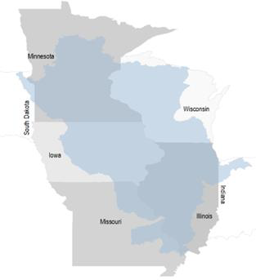
Aquatic Invasive Species (AIS):
Nationally competitive but project must fall within the delineated area of the Upper Mississippi River Basin.

Slide 15
Aquatic Invasive Species (AIS) Research Priorities
Effects: Research that improves our understanding of the effects of aquatic invasive species on lakes, rivers, and associated tributaries in the upper Mississippi River basin, including changes to water quantity, water quality, and ecosystem dynamics.
Characteristics: Research that identifies physical, biological, and chemical characteristics of water bodies that infer resistance and resilience to the distribution, establishment, and effects of aquatic invasive species in the upper Mississippi River basin. Research is needed to better understand these interactions to guide management decisions that will improve invasive species management and result in positive effects on aquatic ecosystems.
Management: Research on assessment of the detection, spread, and management of aquatic invasive species in the upper Mississippi River basin and the connections to human dimensions, both socially and economically. Note that this does not include physical control of AIS.

Slide 16
Per- and polyfluoroalkyl substances
(PFAS) Research Priorities
Media-specific methods: Enhanced methods for detection on specific media, with a clear indication of new or different compounds, new or different methodological approaches (such as non-target analysis [NTA] or suspect screening, proxies, surrogates), lower detection levels for specific media or compounds, especially with respect to EPA health guidelines for PFOA (Perfluorooctanoic Acid) and PFOS (Perfluorooctane Sulfonate).
  Media of interest include (in ranked order):
    tissues/plasma,
    sediment,
    air or interfaces,
    water.

Slide 17
Per- and polyfluoroalkyl substances
(PFAS) Research Priorities
Atmospheric sources: Improved understanding of atmospheric exchange in PFAS distribution and fate. This may include methods to determine transport of PFAS to the atmosphere and to subsequent receiving waters, such as a water method that determines "new" compounds based on their likelihood to occur in the atmosphere.
Processes oriented at molecular level, physical or biological: Process-oriented research of PFAS fate, transport, and effects, with emphasis on molecular-level understanding of PFAS precursor transformation, sorption dynamics, or process-oriented research of mechanisms of PFAS bioaccumulation and(or) biological/ecological effects, or biodegradation of PFAS along source to receptor pathways and identification of mitigation methods and engage modeling and forecasting processes for prediction, prevention, and mitigation of environmental risk of exposure to PFAS in ecosystem and human population.

Slide 18
Federal collaboration
Collaboration with USGS or other federal scientists is encouraged
Federal employees may not be a PI but can be a co-PI
Federal agencies may not receive funds from these grants
  For General ONLY: USGS scientists can obtain internal research funds to support their activities. Additional paperwork required. Funding for collaborator is from USGS, not included in proposal budget.
Contact your state WRRI for assistance in identifying USGS collaborators
https://www.usgs.gov/mission-areas/water-resources/connect

Slide 19
Budget requirements
Up to $310,000 for the General 104g program, 6 awards anticipated
Up to $309,000 for PFAS projects, 9 awards anticipated
Up to $346,875 for AIS projects, 4 awards anticipated
Project duration: 1–3 years
Anticipated project start date: February 1, 2026
1:1 non-federal cost share required per 12-month period
Facilities and Administrative (F&A or ‘indirect costs’) cannot be paid from federal funds
Unrecovered F&A on both federal and non-federal direct costs are used toward the 1:1 match requirement – can be an exception to university policy

Slide 20
Example budget summary – General
Item | Federal | Non-federal | Total
A: Direct costs | 310,000 | 90,500 | 400,500
B1: F&A on federal portion (55% of A:Fed) |  | 170,500 | 170,500
B2: F&A on non-federal portion (55% of A:Nonfed) |  | 49,775 | 49,775
C: Total (A + B1 + B2) | 310,000 | 310,775 | 620,775
NOTE: F&A will differ for each state/institution. Please check with your state WRRI contact.

Slide 21
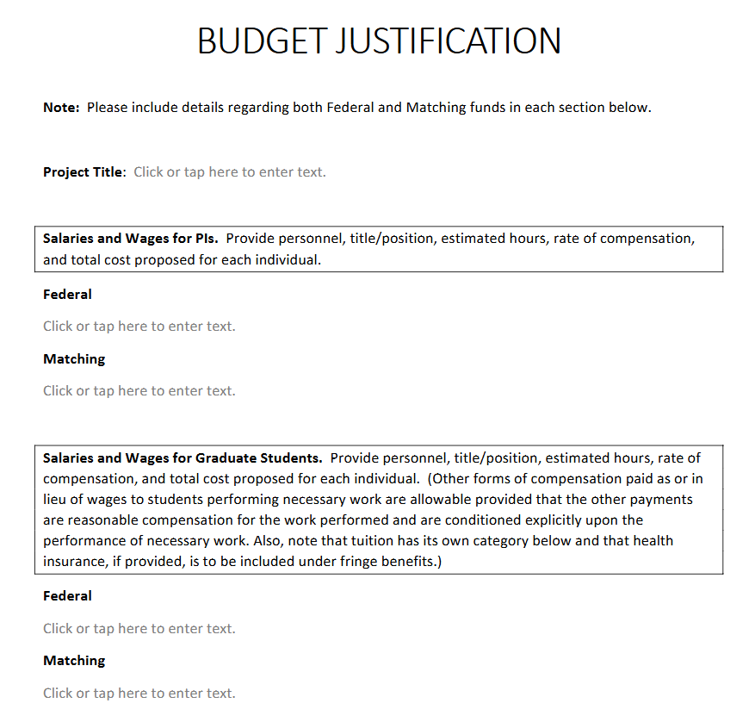
Budget requirements
PIs can request salary from the federal funds, limited to 2 months of salary per year
Budget Justification -
  Justify and distinguish the federal funds requested from the match contribution.
  Provide details
    # of samples / testing kit capacity x number of tests and cost per test
    Subawards to provide same level of detail
Use the USGS-provided templates

Slide 22
Common Budget Issues
Not enough details
  Tuition: # of students, time/# of semesters, rate/semester, and total amount
  Supplies: item name, amount/unit, # of units, cost/unit, and total cost
  Services/consultants: rate, hours, total cost
  Travel:
    actual name of conference, date, location
    trip destination, # of personnel, # of days, per diem rate, lodging rate, mileage and mileage rate or airfare (for each trip)
Unallowed costs
  gifts, gift cards, incentives, gratuities, catering/food
Indirect costs -> include indirect rate agreements
Equipment -> if over $10,000, need a manufacturer’s quote
Subawards -> need just as much detail as in full budget

Slide 23
Free advice for making proposals competitive
Connect with other teams who are applying to the same RFP
Very low chance of USGS funding two proposals that are similar
Differentiating proposals will improve everyone’s chances
Student involvement
Regionally or nationally important (doesn’t mean you need people spread throughout the region, but that the research needs to be regionally relevant)
Make sure you READ the review criteria from the RFP as you write your proposal
Make sure to answer the specific priority stated in each RFP

Slide 24
Breakout Rooms
Breakout Options (facilitator in each)
AIS
PFAS
General
Stay in main room for high-level / budget questions
Suggestions for discussion
Introductions
Topic/areas of interest - if willing to share
Collaboration interests
Other questions

Slide 25

WRRA Program Manager
Christian Schmidt –
cgschmidt@usgs.gov
Notes:
Mention USGS Environmental Science Centers with AIS programs (opportunity for collaborators, stress that we have to work on the water and not the invasive species itself)

